Slide 1
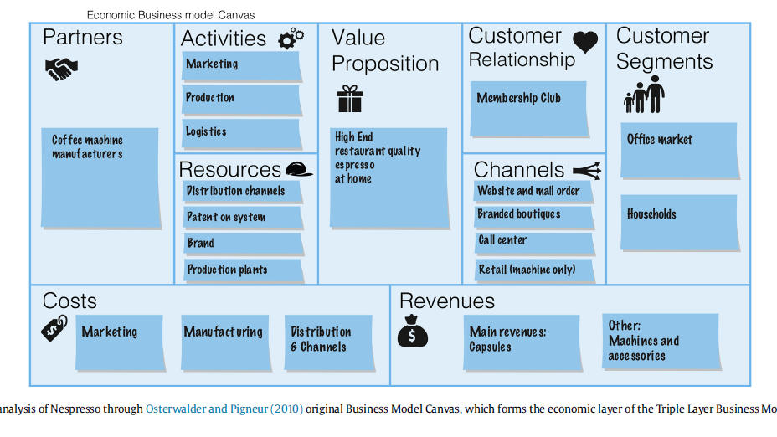

Slide 2
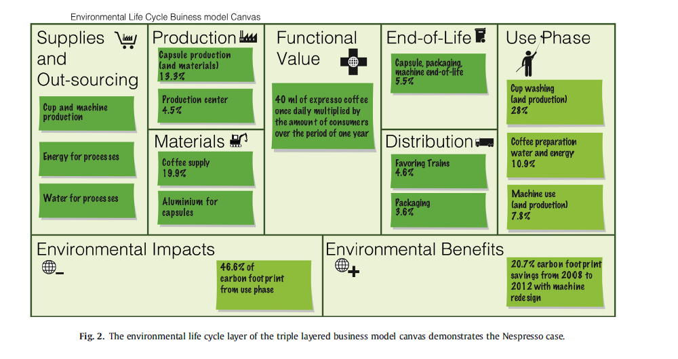

Slide 3
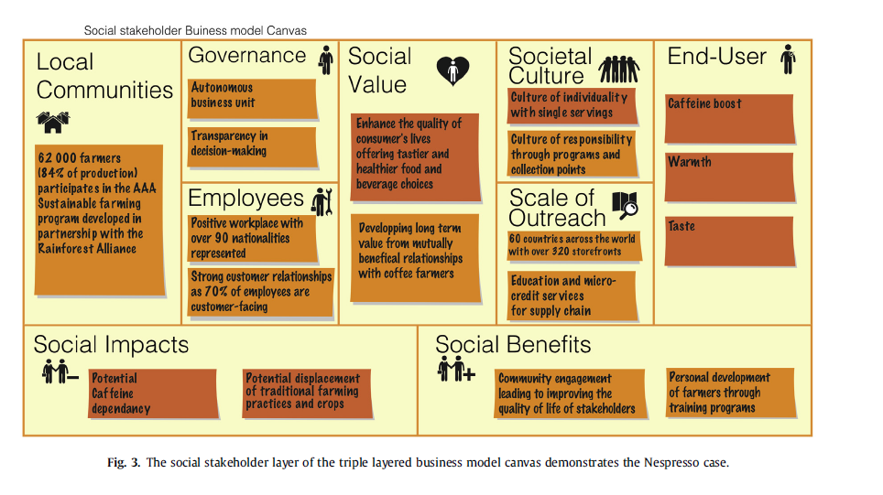

Slide 4
Source: Joyce, A.; Paquin, R. & Pigneur, Y. (2015): The triple layered business model canvas: a tool to design more sustainable business models, ARTEM Organizational Creativity International Conference, 26-27 March 2015, Nancy, France.

